Slide 1
Book Management System
BY: JOHN NGUYEN, AARON MARKOWITZ, and ALEXANDER FATJO

Slide 2
Table of Content
File Operations
GUI

Slide 3
Project Goal & Abstract
Create a universal Book Management Program that can run on nearly all computers(are not specific to windows, mac or linux).
Simple UI to allow all to use.
Understand File Handling better

Slide 4
Why Book Management?
File handling is an interesting feature and can provide a way to save changes permanently while the code is running instead of the program resetting to its base values. This project can be used to make a realistic, useful program that can be improved.

Slide 5
Software requirements
[Headers]
conio.h
fstream
iostream
limits
strings
WinForms

Slide 6
File Operations
fstream commands for c++(source code)
Streamwriter(c#/winforms)
>StreamWriter.
>Write, Read, Close, etc.(Similar to fstream).

Slide 8
UI-Properties
localizable Forms:
>Determines if there will be Elements/Data specific to said window(Form) or if it’s purely UI.
Element Validation:
>Enabling 'causes validation' for objects(buttons) in order to trigger an event
>Ex: needed for buttons, UI guidance(linking to another form, or exiting), and any other interactive Elements within the form.
Member Generation:
>Generate member specific to elements in order to initialize/implement said data.
Sizing:
>All forms and elements within are locked.
>Anchoring elements to top, left, and center in order to scale acording to size of window.

Slide 9
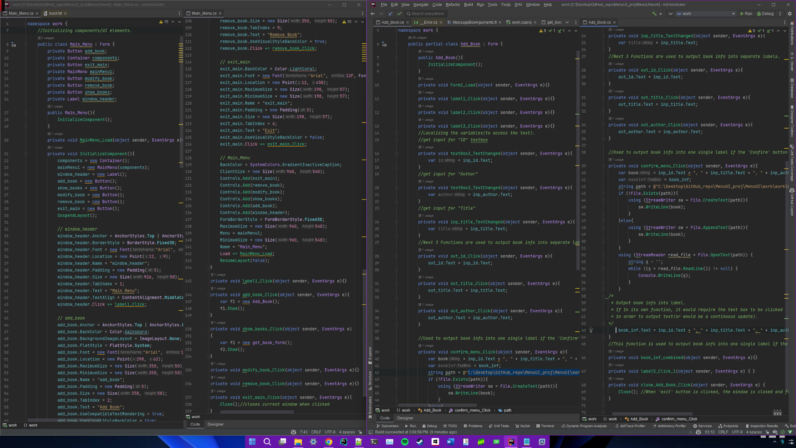

Slide 10
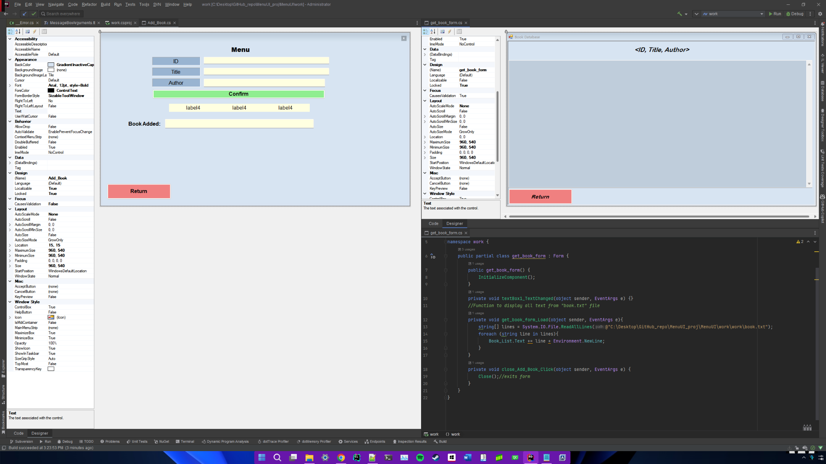

Slide 11
Troubleshooting
‘clear_screen()’ function is a universal alternative to ‘system(“cls”) which is OS-specific.
This is done by outputting a specific number of ‘newline’s(using ‘string(# of lines, ‘\n’)’)
cin.ignore removed any unnecessary inputs in the input buffer which caused some issues when appending something into the file.
Required Admin Privilages In order to access any files depending on their location

Slide 12
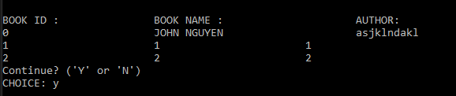
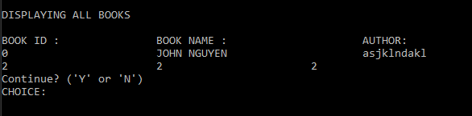
Troubleshooting cont.
An issue that came up and still needs work is that when you delete a file it deleted the line, therefore the one below that one becomes the new one but it still says the same id as when it was in that line but now it’s technically in the new spot. EXAMPLE:
Before:
After:
The problem this causes is that “2” is now technically in the “1” slot and when you try to edit it it needs the input of 1 instead of 2.

Slide 13
Conclusion
Our goal for this project was to create an easy and accessible system for users to access books. Not only is it for the benefit of the users, but the ability to organize and store books and their status allows the library management to stay organized and have no issues regarding their inventory. The purpose of this program is remove the stress and difficulty of manual book handling which is subject to error through human mistakes, natural occurrences, etc. Using a digital system is much more beneficial for storage purposes and overall efficiency.

Slide 14
Program Execution

